Slide 1
Impact of Flow-dependent Assimilation using Adjoint Model including 3-ice Microphysics Scheme
Yasutaka Ikuta
Japan Meteorological Agency / Meteorological Research Institute
The 4th International Workshop on Nonhydrostatic Models
Nov. 30 (Wed) - Dec. 2 (Fri), 2016
The Prince Hakone Lake Ashinoko, Hakone, Japan

Slide 2
Outline
Introduction
Cloud microphysics for data assimilation
Flow-dependent assimilation
Summary

Slide 3
Introduction
Japan Meteorological Agency has been developing a new meso-scale hybrid 4D-Var data assimilation system using flow-dependent background error estimated from ensemble forecasts.
Main aim
Improvement of short-range precipitation forecasts
Data assimilation of radar reflectivity and cloudy satellite radiance
The detailed information of hydrometeors and cloud microphysics scheme is necessary.

Slide 4
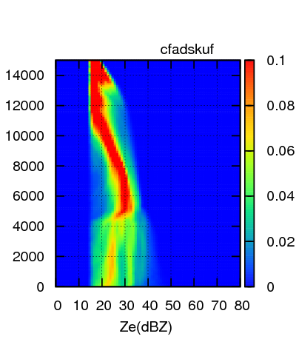
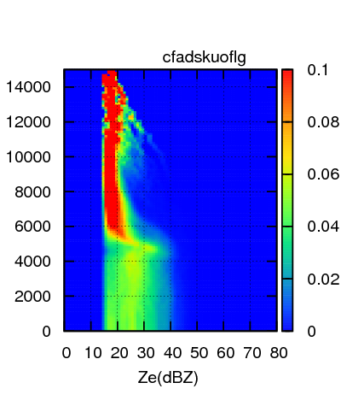
Cloud Microphysics for DA
Forecast model
Requirement:
Precipitation accuracy
For disaster prevention
Data assimilation
Requirement: Unbiased hydrometeors profile
For assimilation of reflectivity and brightness temperature
Forecasted hydrometeors profile has bias in JMA operational model.
The reason of bias:
Assumption of shape, size distribution and density about solid precipitation particle.
Simulation
Observation
KuPR
KuPR
We need unbiased cloud microphysics scheme for data assimilation.

Slide 5
Cloud Microphysics for DA
Development of MP_ASM (microphysics for assimilation)
Simplified 6-class 3-ice 1-moment bulk cloud microphysics scheme
Prognostic hydrometeor types
Mixing ratio: Cloud, Rain, Ice, Snow and Graupel.
PSD
Mono-dispersion: Cloud and Ice
Exponential: Rain and Graupel
Exponential + modified gamma: Snow
Tangent-linear and Adjoint model to support variational DA
Fixed variables on background trajectory
Air density and pressure
Diffusivity of water vapor, thermal conductivity of air

Slide 6
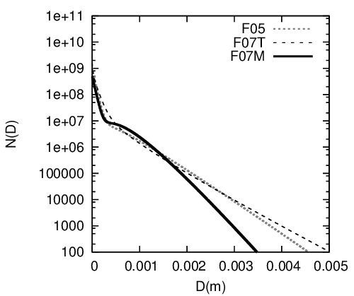
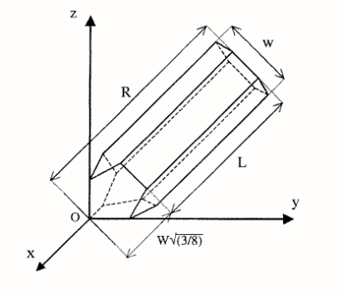
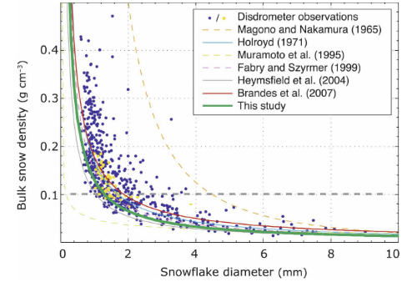
Cloud Microphysics for DA
Changing of definition about ice and snow
Ice particle
Snow particle
Shape: Bullet
Hong et al. (2004)
T=-10 ℃, Qs=0.2 g kg⁻¹
Operational model
Spherical particle
Operational model
PSD: exponential
Spherical hard-particle
Heymsfield and Iaquinta (2000)
PSD: Exponential + Modified-gamma
PSD: Mono-dispersion
For midlatitude cloud (Field et al. 2007)
Mass
Ice <--> large snow flake
Mass
Bulk snow density
Thompson et al. (2008)

Slide 7
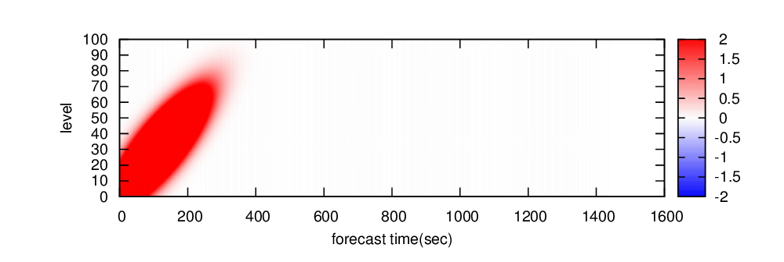
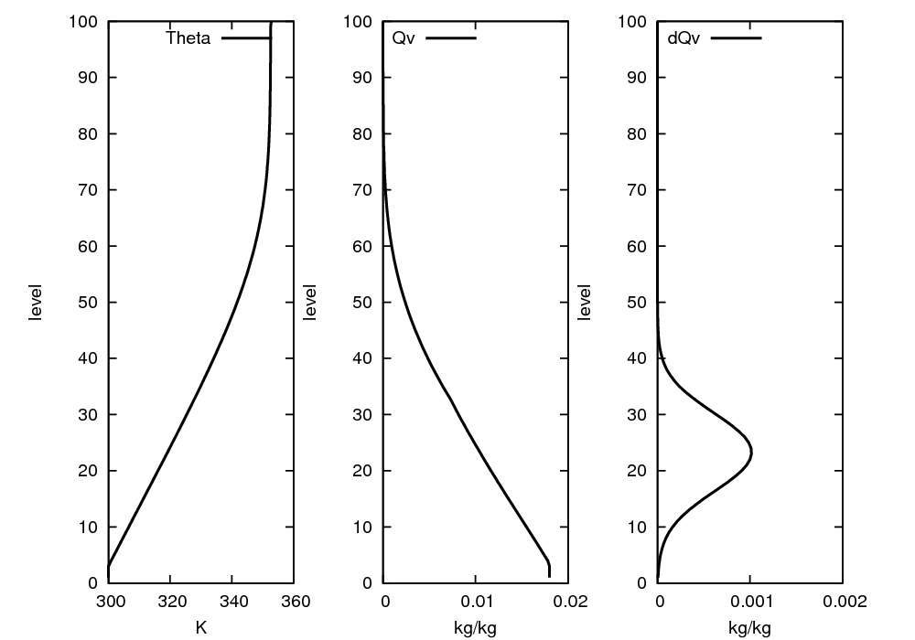
Test of MP_ASM using Single Column Model
 | Single column TL/AD model based on KiD*
Variables | P(pressure), T(temperature), Qv(specific humidity), Qx(mixing ratio of hydrometeors x) x=cloud, rain, ice, snow and graupel
Vertical resolution / number of level | 160 m / 100 levels
Time step | 5 sec
* Shipway and Hill (2012)
Initial condition
Forcing
initial perturbation
Vertical velocity
time step

Slide 8
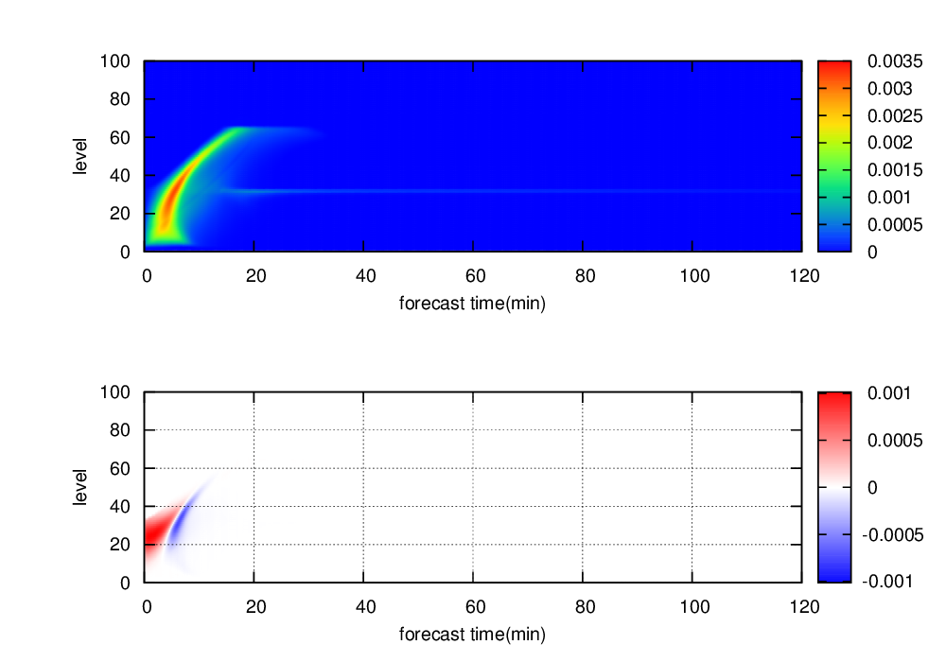
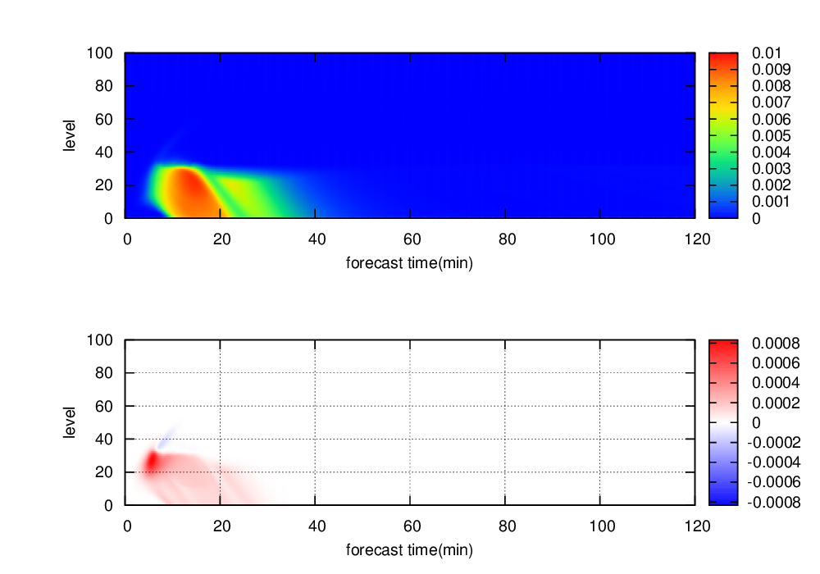
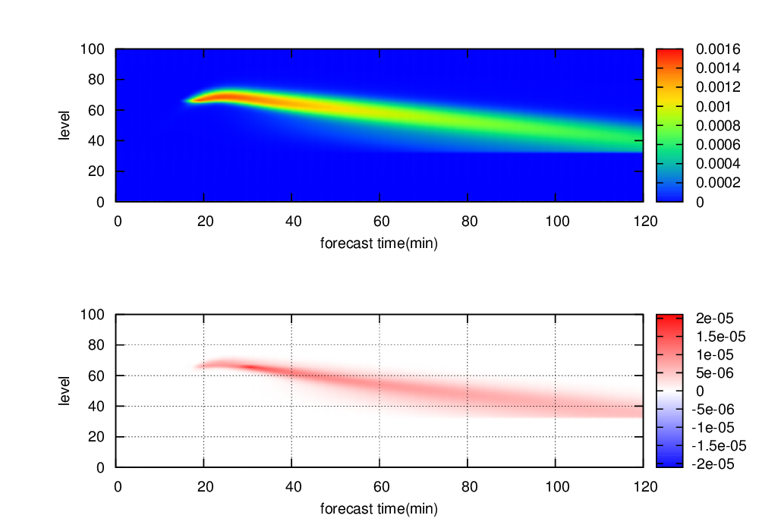
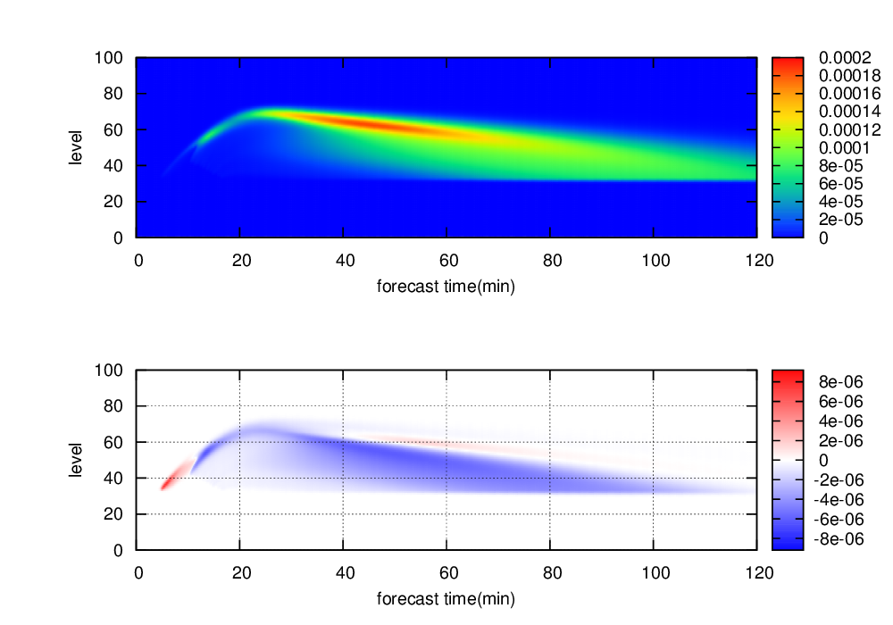
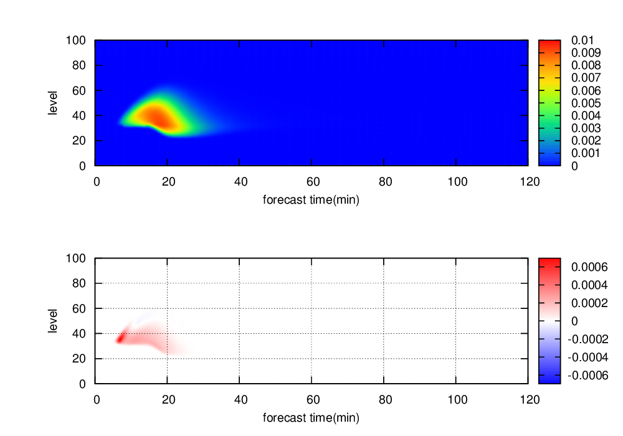
Non-linear and Tangent-linear Model of MP_ASM
Qc
Qr
Precipitation
Non-linear
Tangent-linear
Qi
Qs
Qg

Slide 9
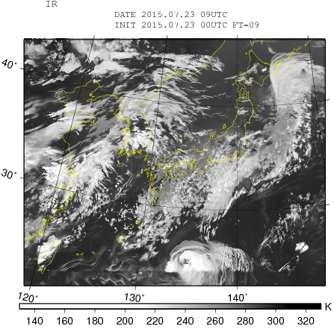
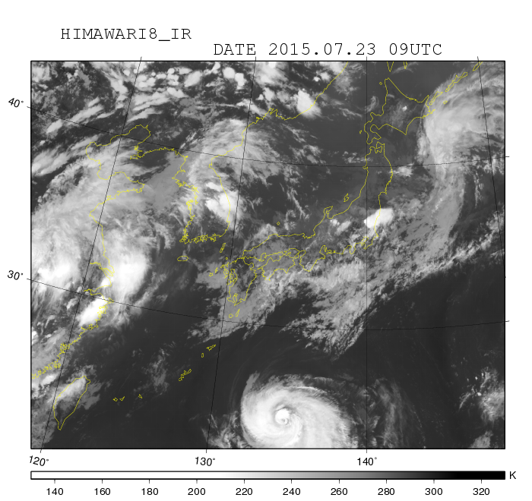
Infrared imager 10.6 μm Comparison of Operational Model and Observation
LFM: 2 km operational model
Observation (Himwari-8 AHI)
Lead time: 9-hour
Relaxation area
Model’s Tb is lower than Obs.

Slide 10
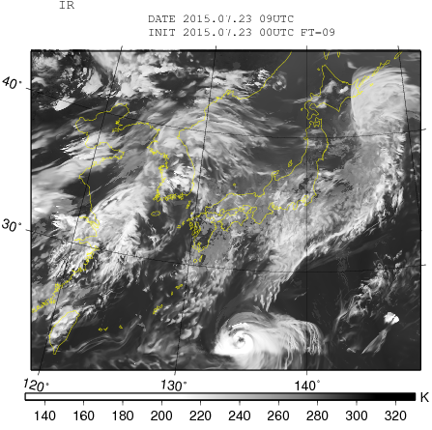
Infrared imager 10.6 μm Comparison of MP_MSM and Observation
LFM with MP_MSM
Observation (Himwari-8 AHI)
Lead time: 9-hour
MP_MSM: cloud microphysics of new MSM
Relaxation area
Model’s Tb is lower than Obs.

Slide 11
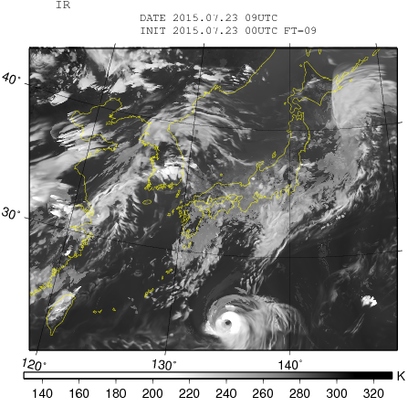
Infrared imager 10.6 μm Comparison of Non-linear MP_ASM and Observation
LFM with MP_ASM
Observation (Himwari-8 AHI)
Lead time: 9-hour
F05
Relaxation area
Similar brightness

Slide 12
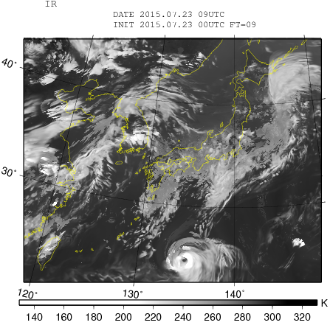
Infrared imager 10.6 μm Comparison of Non-linear MP_ASM and Observation
LFM with MP_ASM
Observation (Himwari-8 AHI)
Lead time: 9-hour
F07M
Relaxation area
Similar brightness

Slide 13
Is Unbiased Scheme Best ?
Forecast
Cloud microphysics must be balanced other physics processes (e.g. convective parameterization, radiation and planetary boundary layer scheme ).
Data assimilation
Unbiased hydrometeors profile is very important to simulate reflectivity and brightness temperature.
In this assimilation study, unbiased hydrometeors is a first priority.
Development of unbiased scheme
-> feedback to development of forecast model.

Slide 14
Flow-dependent assimilation

Slide 15
Flow-dependent Assimilation
Extended control variable method (Lorenc 2003)
Background error covariance
Mixing the climatological error and the ensemble estimated error
Spatial localization
(time propagation ignored)
Control variables
Extended control variables
Cost function
Innovation vector (observation-guess)
Observation term
Tangent-linear model operator
Observation operator (e.g. Radar simulator, RTTOV)

Slide 16
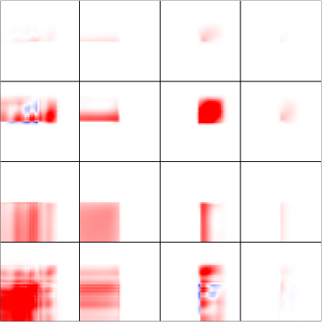
BG Error Covariance of Hydrometeors
Cost function
Climatological term
Analysis increment does not depend on meteorological environment sufficiently.
Flow-dependent term
BG covariance given by ensemble forecasts provides flow-dependent analysis increment.
Benefit of flow-dependent term
Flow-dependent background error covariance of hydrometeors by ensemble forecasts
Accurate analysis increment in a variety of situations
→ Flow-dependent hydrometeors analysis
W Qr Qs Qg
W Qr Qs Qg
pseudo ensemble: columns in first guess

Slide 17
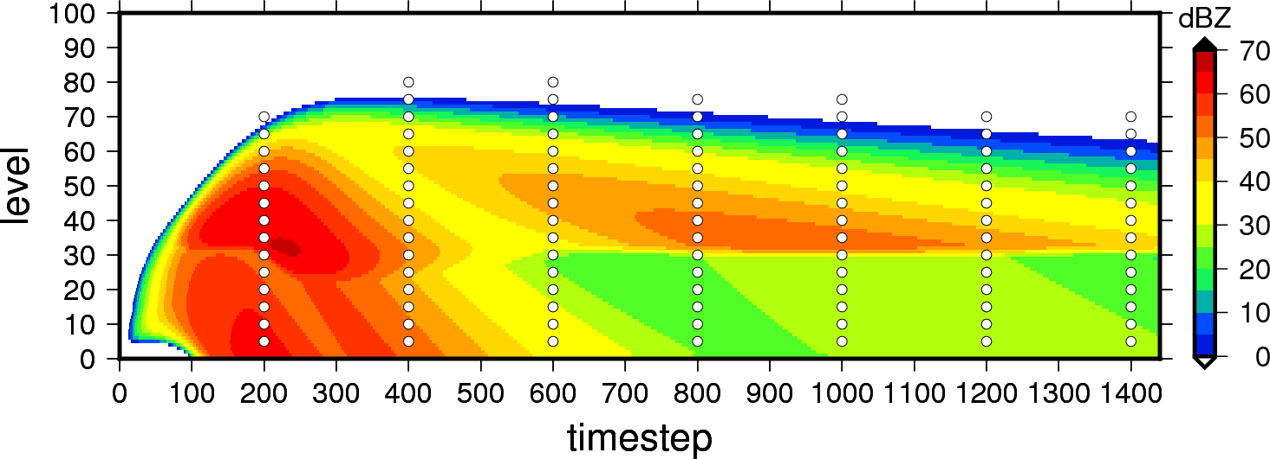
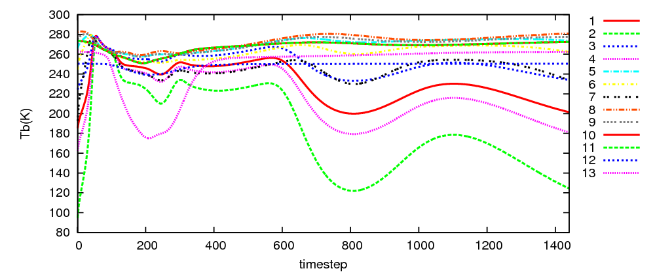
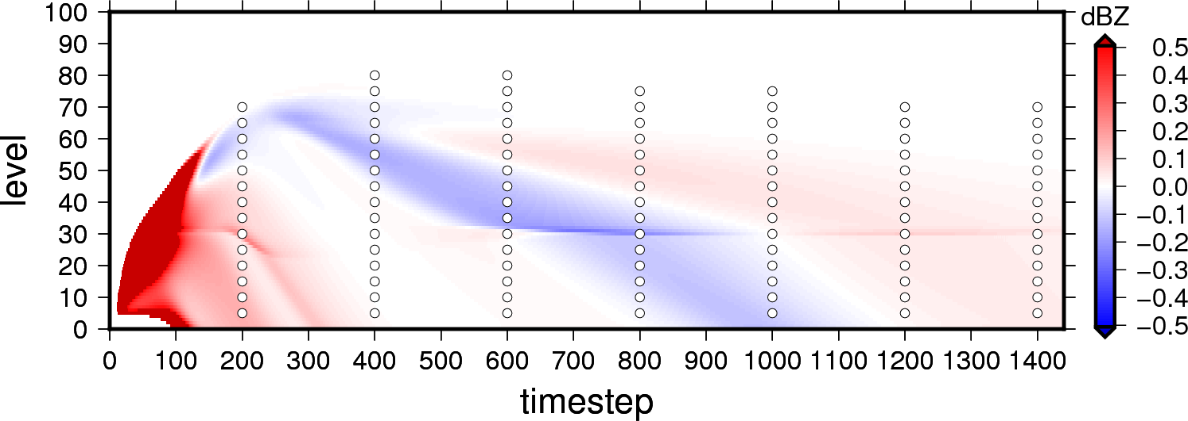
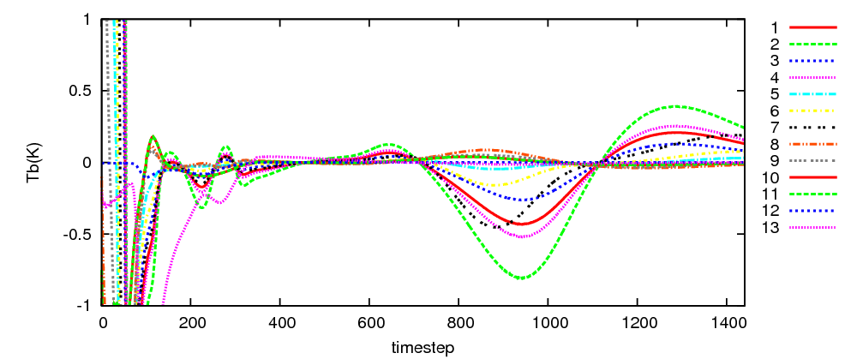
Identical Twin Experiment
Reflectivity
Brightness temperature
Guess
○: Observation points
Guess
True-Guess
True-Guess
RTTOVSCATT (rttov11.3 by EUMETSAT)
Satellite: GPM, Sensor: GMI, Frequency: 1) 10.65 GHz(V), 2) 10.65 GHz(H), 3) 18.7 GHz(V), 4) 18.7 GHz(H), 5) 23.8 GHz, 6) 36.5 GHz(V), 7) 36.5 GHz(H), 8) 89.0 GHz(V), 9) 89.0 GHz(H), 10) 165.5 GHz(V), 11) 165.5 GHz(H), 12) 183.31±3 GHz, 13) 183.31±8 GHz
Observation operator of reflectivity is not used Qc, Qi and Qv.

Slide 18
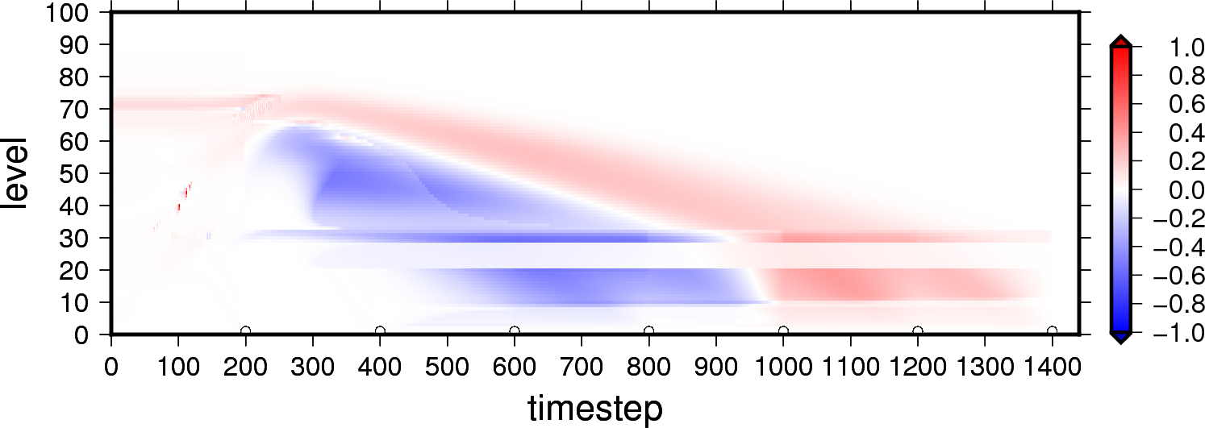
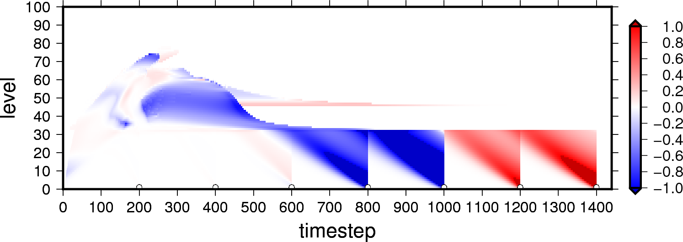
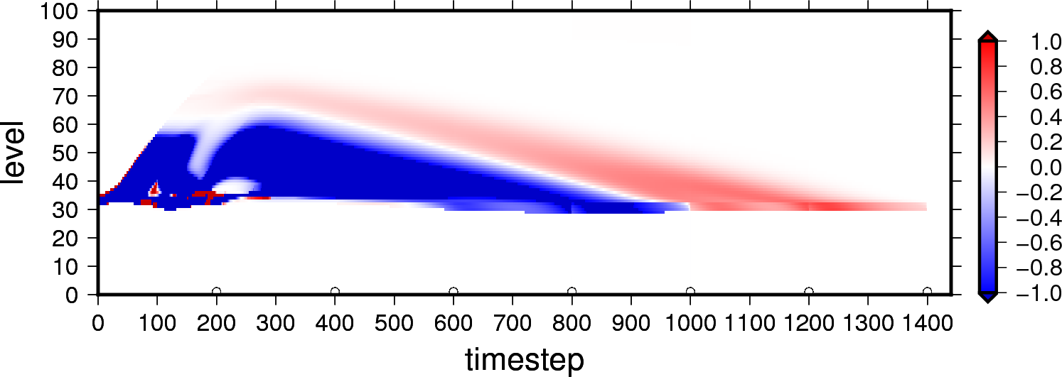
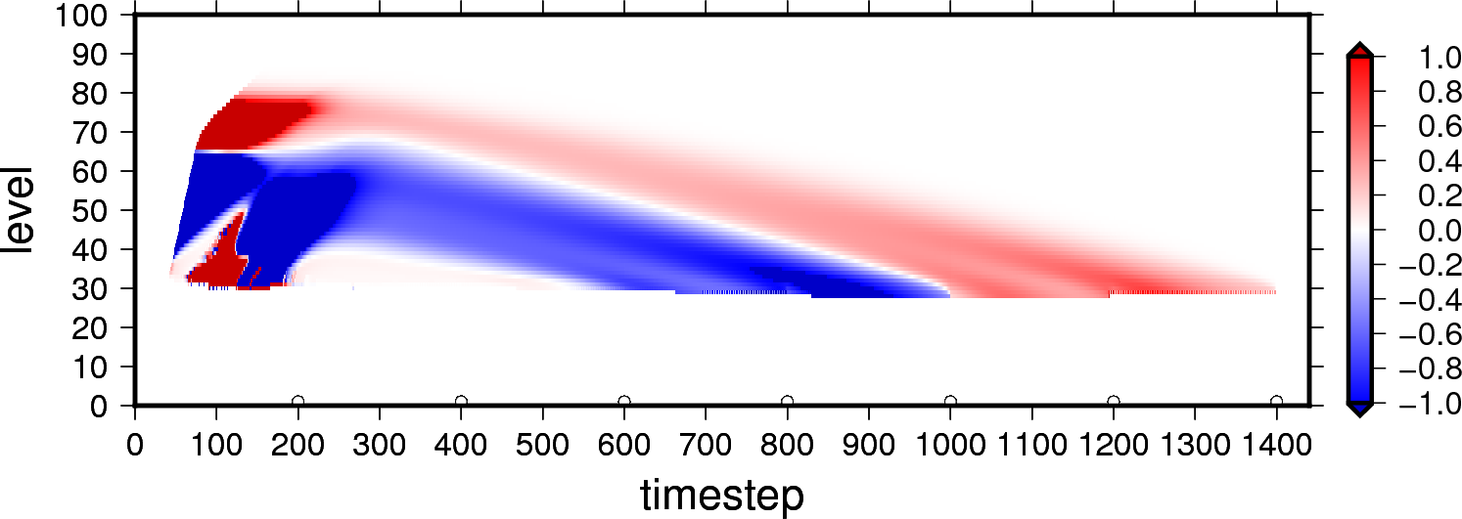
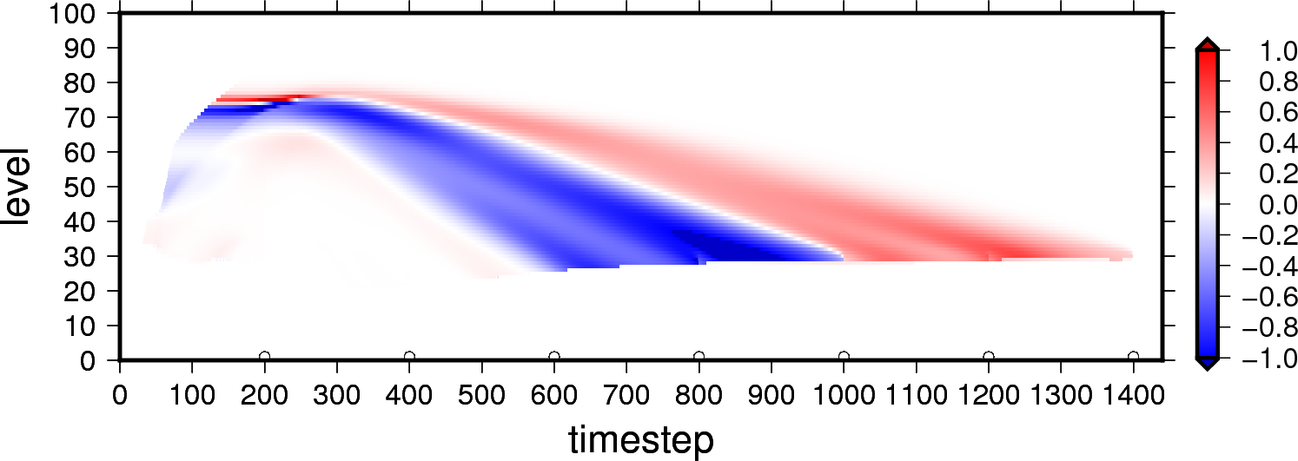
Gradient Vector Relating Hydrometeors
Reflectivity
Observation
Brightness temperature
Observation
Qv
Saturated layer
Qc
Qr
Qi
Qs
Qg
Gradient of water vapor, cloud and ice are given by
AD model of cloud microphysics.
Gradient vector

Slide 19
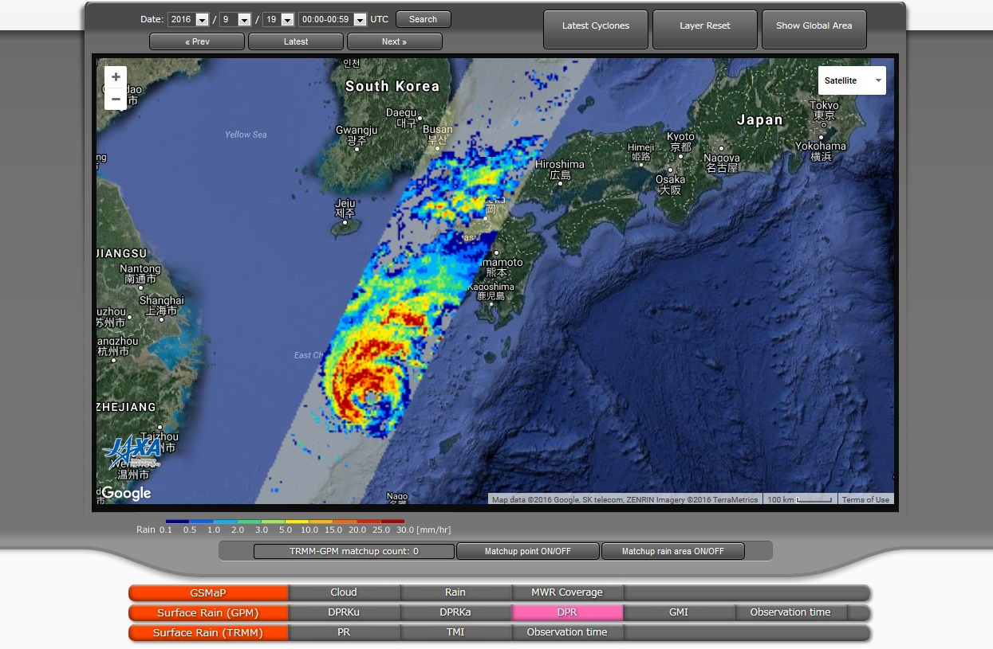
Impact Experiment using Real Observation Data
GPM Near-realtime Monitor (http://sharaku.eorc.jaxa.jp/trmm/RT3/index.html)
2016/09/19 00:49:00
GPM/DPR
2016/09/19 00:46:30

Slide 20
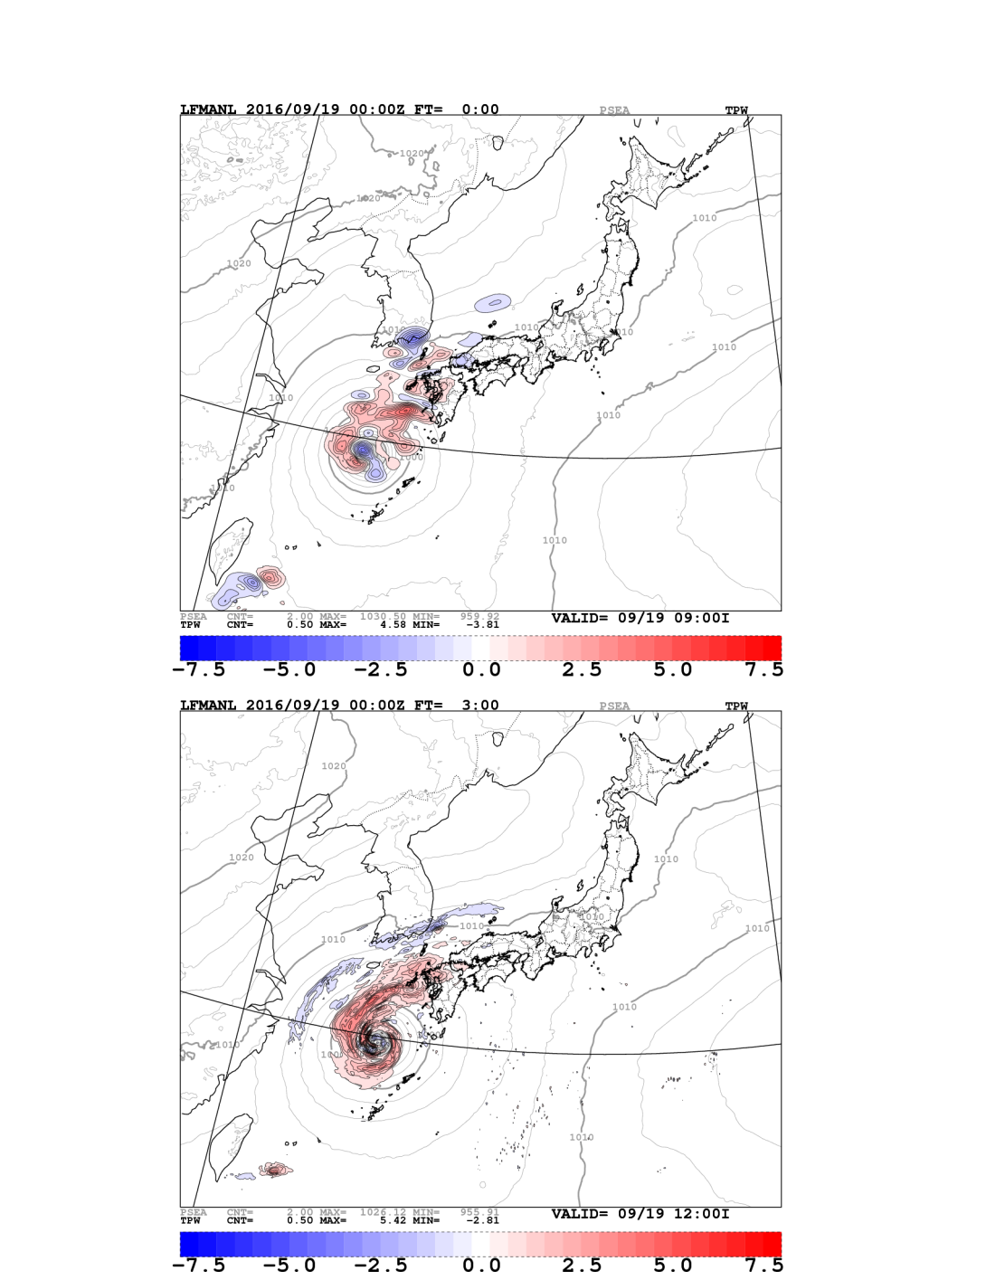
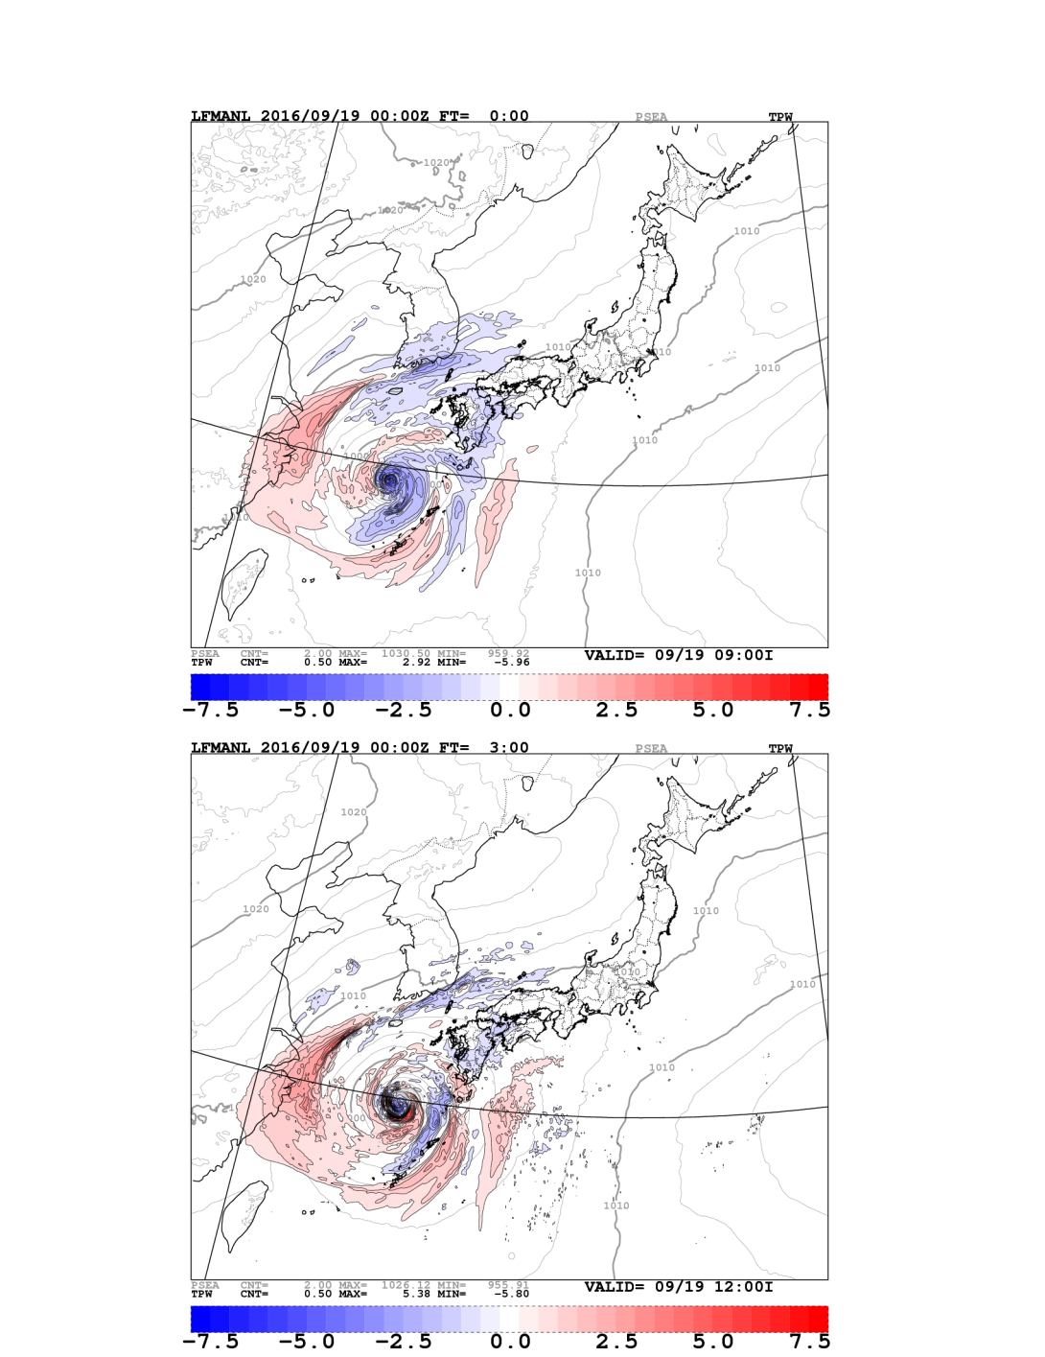
Increment
Climatological(100%)+Ensemble(0%)
Climatological(50%)+Ensemble(50%)
2016/09/19 00:00:00
-3-hour
-3-hour
Nm=13
Start of assimilation window
DPR scan time :
00:40:00 – 00:50:00
Localization radius was set to 300 km.
It may be too large…
Total Precipitable Water
Total Precipitable Water
2016/09/19 03:00:00
0-hour
0-hour
End of assimilation window
5 km resolution

Slide 21
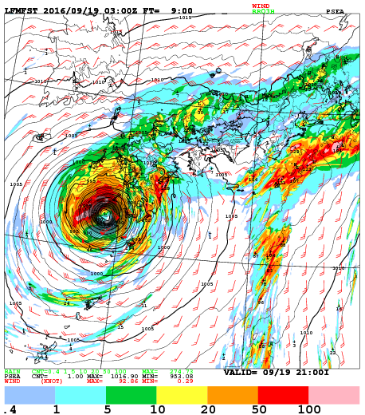
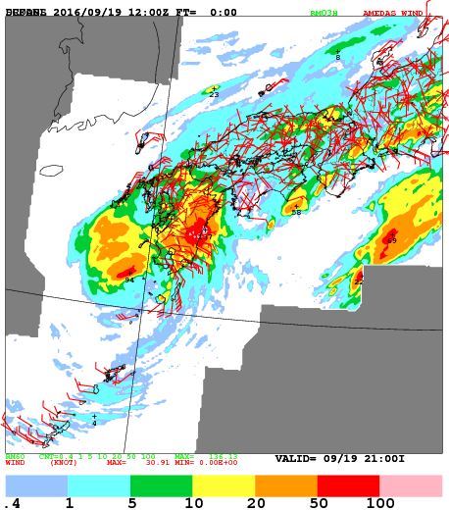
Precipitation of Forecast
Climatological(100%)+Ensemble(0%)
Observation
Lead time: 9-hour

Slide 22
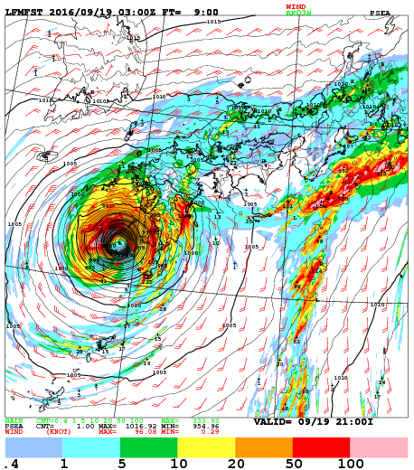
Precipitation of Forecast
Climatological(50%)+Ensemble(50%)
Observation
Lead time: 9-hour

Slide 23
Precipitation of Forecast
Climatological(100%)+Ensemble(0%)
Climatological(50%)+Ensemble(50%)
Observation
Overestimated precipitation was reduced in the experiment using initial condition made in flow-dependent assimilation.

Slide 24
Summary
Cloud microphysics for DA
The bias of cloud forecast is successfully reduced.
Tangent-linear and Adjoint model is included to support variational DA.
Advantage of flow-dependent DA
Test of observation operator relating to hydrometeors
Gradient of water vapor, cloud and ice is given by Adjoint model.
Error correlation of hydrometeors is given by ensemble BG covariance.
Precipitation forecast is improved using flow-dependent DA
Future work
More case study targeting severe weather event.
Statistical verification of long-term.

Slide 25
Thank you for your attention

Slide 26
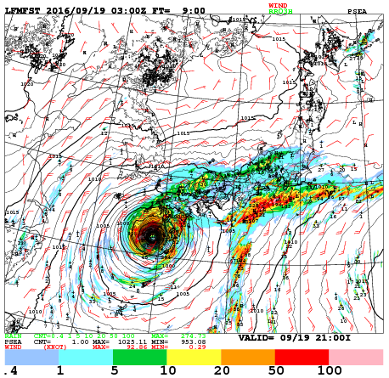
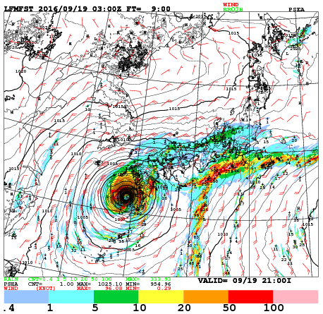
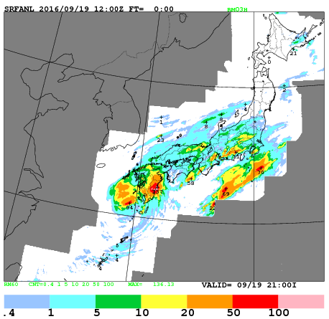
Precipitation of forecast
Climatological(100%)+Ensemble(0%)
Climatological(50%)+Ensemble(50%)
Observation

